Slide 1
HIGHER EDUCATION in Italy

Slide 2
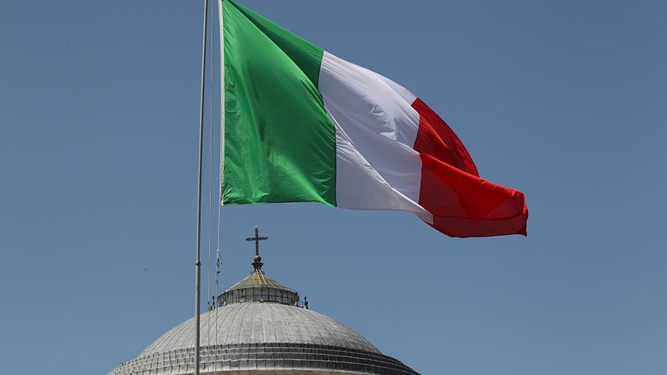
The system of higher education includes two types of educational institutions - universities and institutes and colleges in Italy.
The university education sector consists of 83 universities, including:
58 public (Univarsitastatali);
17 private, accredited at the state level (Universitanonstatali, legal mentericonosciute);
2 universities for international students (Universitaper Stranieri);
3 higher schools specializing in postgraduate studies (ScuoleSuperiori);
3 polytechnic universities (Politecnici).

Slide 3
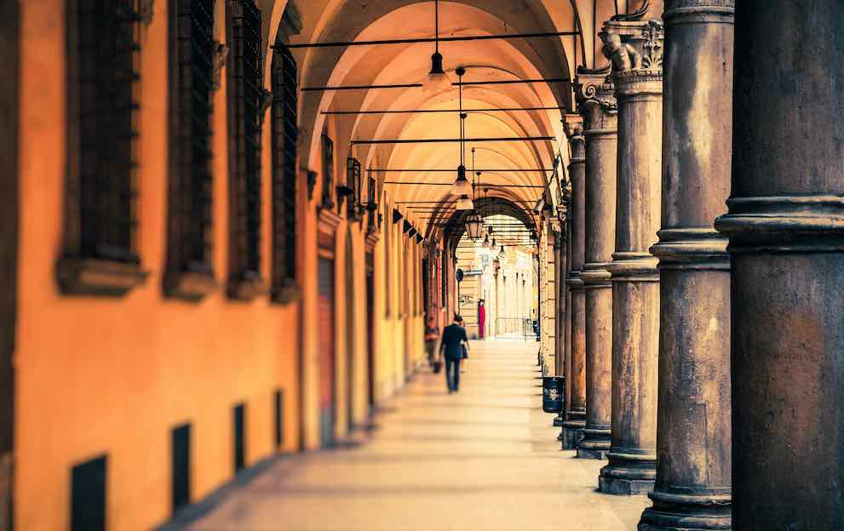
In addition to universities, higher education is possible get in the following four types of educational institutions:
higher schools of design; polytechnic institutes of arts, academies of arts, conservatories and accredited music institutes, higher schools of music and choreography, national academies;
higher schools of language training;
Higher Schools of Integrated Learning
institutions that are subordinated other ministries and where specialists are trained in certain areas

Slide 4
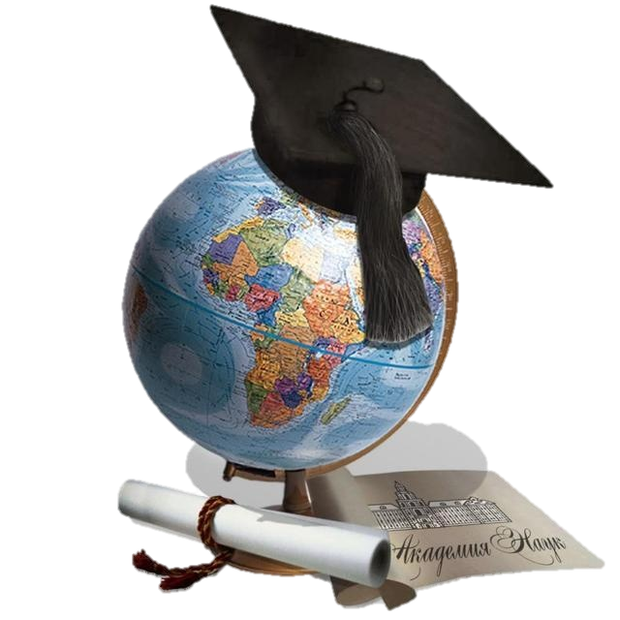
DEGREES:
I DEGREE
Students take a bachelor's program. Education at the first level of higher education lasts 3 years.
II DEGREE
Students can be trained in training programs. Duration of training from 2 to 3 years.
III DEGREE
Postgraduate training includes a research program with the award of the degree of Doctor of Science

Slide 5
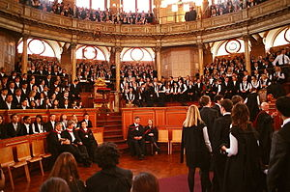

The rules of admission to an Italian university:
1. An entrant to an Italian university must reach the age of majority (18 years).
2. Since in Italy there is a 13-year education system, and to meet the level of a graduate of an Italian lyceum, after school you need to unlearn 2 years in a Ukrainian university.

Slide 6


INTERESTING FACTS
The school year begins on November 5 and ends on May 31.
There are three sessions a year
Each exam requires 99.9% of self-preparation
Not everyone copes with exams: only three out of ten entrants reach the diploma
To obtain a laurea diploma you need to study for four to six years
Upon completion of the course of any level, students defend their thesis.
The basis of evaluation for it is the arithmetic mean results of all exams passed by the student.

Slide 7
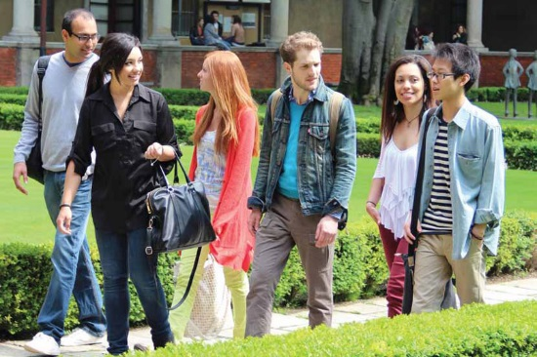

One of the brightest holidays of Italian students is the dedication to these same students.
Italians consider their education quite expensive.
Textbooks and books in Italy cost crazy money ($ 80-150 per textbook), and they need more than a dozen.
The cost of a year of study at the university averages $ 500.
Multiply all by at least 4 years of college and you get $ 50 thousand.

